Slide 1
Mailbox Nofitier
By David Sørensen

Slide 2

Mail or not?
The struggle not knowing when we got mail

Slide 3

Mailbox Notifier
Detect when the mailslot has been open
Notify you by visial and online
When your comming or going
When you didn’t notice the postman or is simply not home.
Tell system you got your mail
Online
Restarting system

Slide 4
Requirements
When slot is opened
Flag is set
Sms is to be sent
When mail is retreived, the system can be reset with a system reboot

Slide 5

Technical challenges
Send sms with photon
Get phone-number with Twilio
Create integration in console.particle

Slide 6
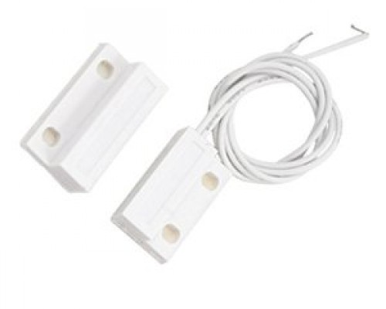
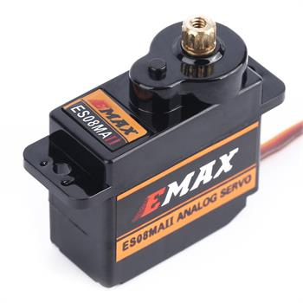
Hardware
Sensor to register an open mailslot
Analog reading
0 when connected
Servomotor to set flag
Notes:
Magnetic contact
Servomotor

Slide 7
Testing
Servo motor
Power with battery
Controle with particle app
Set servo-angel
Sensor (done)
Connected it to an analog pin
Read from it with particle app
Both when connected and disconnected
SMS (done)
Setup twilio account
With phone-number
Create an integration feature on console.particle
Test with test-script

Slide 8
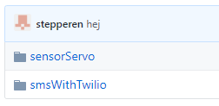
Github
https://github.com/stepperen/IOT

